Slide 1

FoxPlus Mechanical Layout and Design
FoxPlus
43rd Annual AMSAT Space Symposium and Annual General Meeting
G. Andrew Robinson (gar3181@gmail.com)
KA3WDW
17Oct2025

Slide 2

Agenda
01 | FoxPlus Overview
02 | Hardware
03 | Integration Challenges
04 | SV Assembly
05 | Current Status
06 | Path Forward

Slide 3
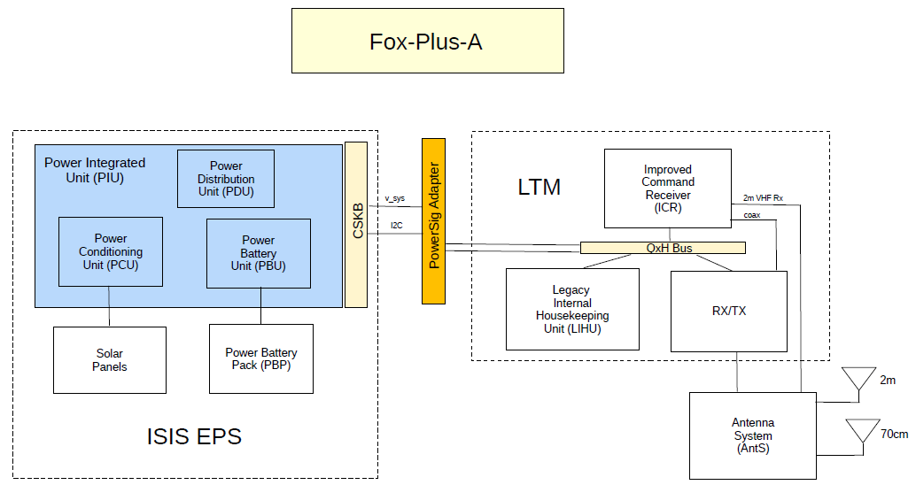
FoxPlus Overview
1U CubeSat design leveraging heritage AMSAT electronic “guts”
Utilize COTS hardware to promote accelerated timeline to launch
  Hardware procured for FoxPlus-A and –B
LEO orbit

Slide 4
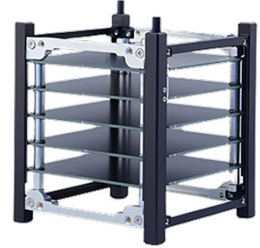
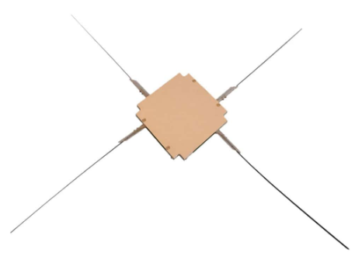
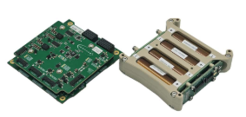
FoxPlus COTS Hardware
Leveraging COTS 1U hardware from Innovative Solutions in Space (ISISpace) – isispace.nl
  1U Frame
  Power Battery Pack (PBP)
  Power Integration Unit (PIU)
  AntS UHF/VHF Deployable Antenna
  Solar Arrays (not shown)
AntS
1U Frame
Power Integration Unit
Power Battery Pack
Images from isispace.nl

Slide 5
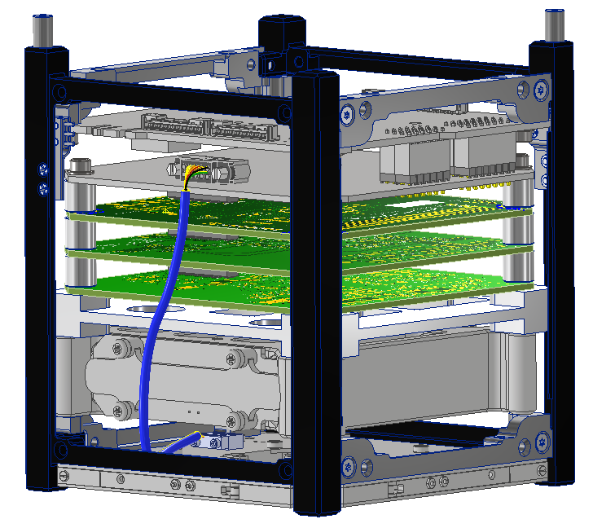
FoxPlus Layout Overview
ISISpace 1U Frame
ISISpace Power Integration Unit (PIU)
FOX-ME-204 Power Signal Adapter (PSA)
LIHU
ICR
RXTX
FOX-ME-203 Mechanical Adapter
ISISpace Power Battery Pack (PBP)
ISISpace AntS

Slide 6
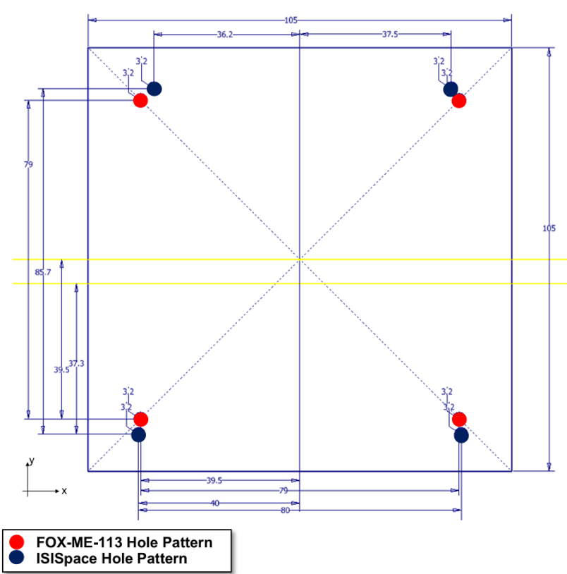
Integration Challenges
Non-symmetric ISISpace hole pattern (frame, PBP, and PIU) present an integration challenge with PCB’s built to FOX-ME-113
1U volume constraints restrict options to move the pattern in the XY-plane
Adapter design challenged by proximity of holes; thru-holes or keenserts needed to facilitate mountain schema
PCB stack-up considerations needed to maximize available space

Slide 7
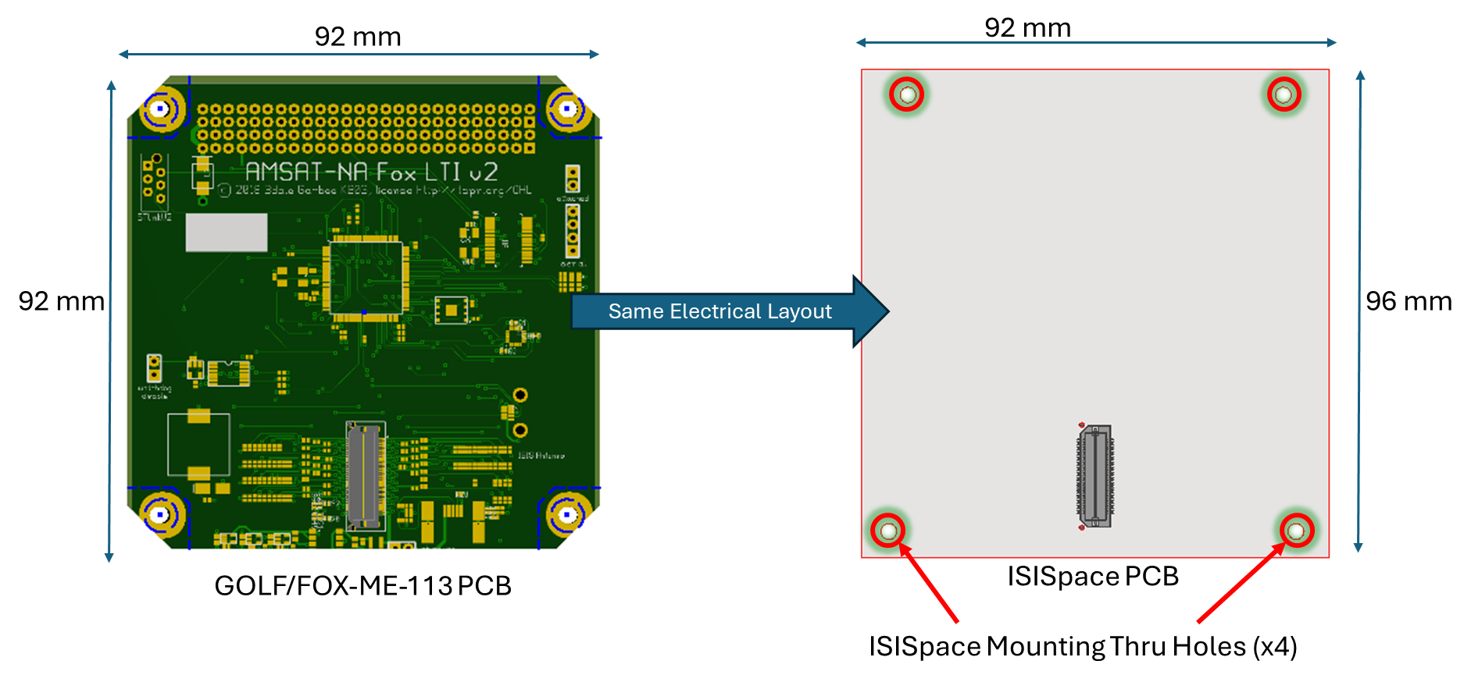
COA#1 – Adopt ISISpace Mounting
Pros | Cons
Easy mechanical integration | New boards need designed/made
Leverage ISISpace assembly | Incompatible design
Space efficient | New ICD

Slide 8
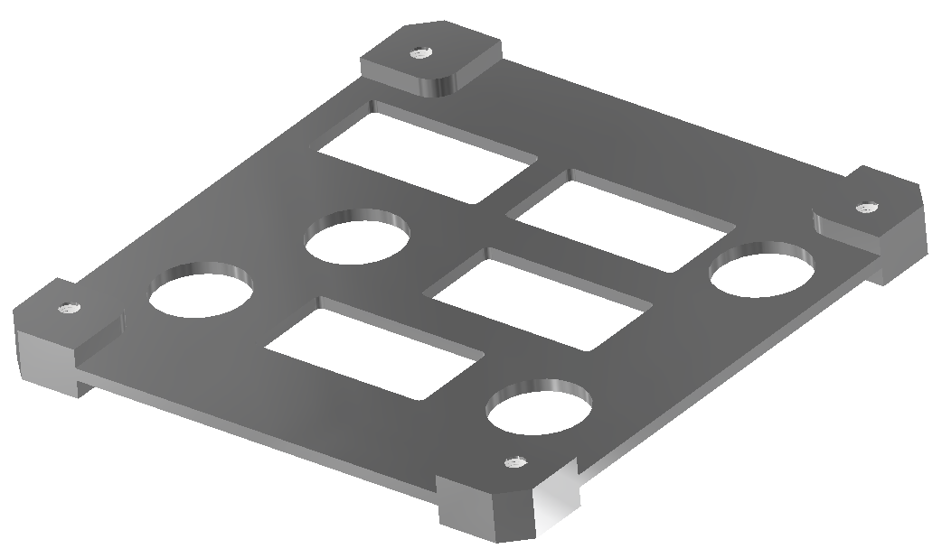
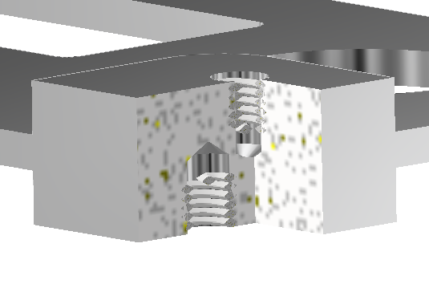
COA#2 - Adapter Design
(4) GOLF/FOX-ME-113 hole pattern on top (mate with RXTX/ICR/IHU stack)
(8) M3 Helicoils
Minimal difference between hole patterns makes this challenging
(4) ISISpace hole pattern on bottom (mate with battery)
Pros | Cons
Uses existing LTM design/boards | Complicated integration
 | Less space for PCBs
 | Shock/vibe risk
¾-X Section

Slide 9
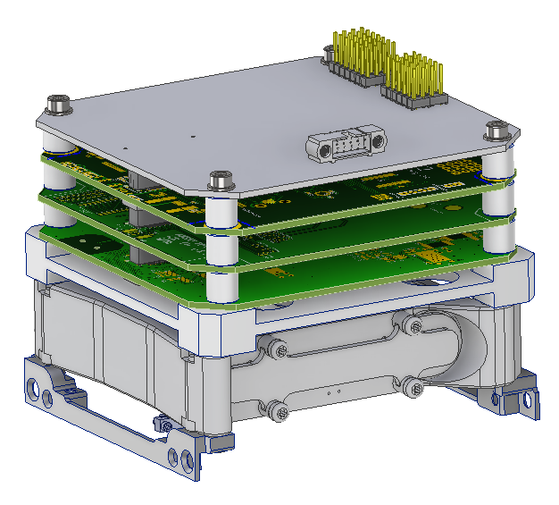
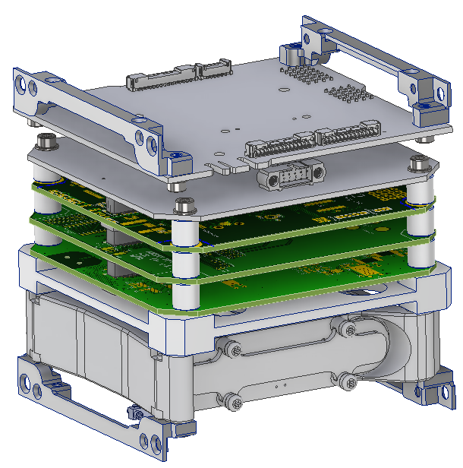
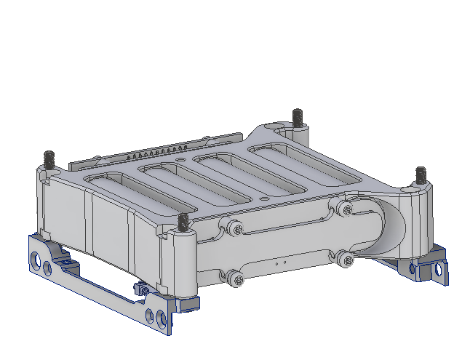
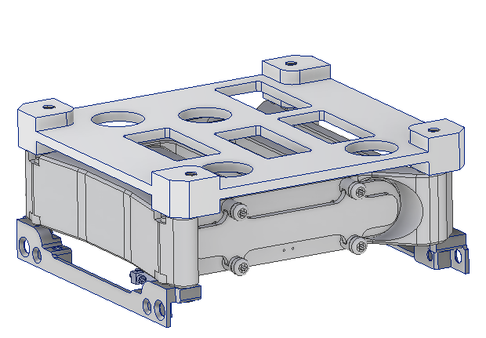
Assembly Process

Slide 10
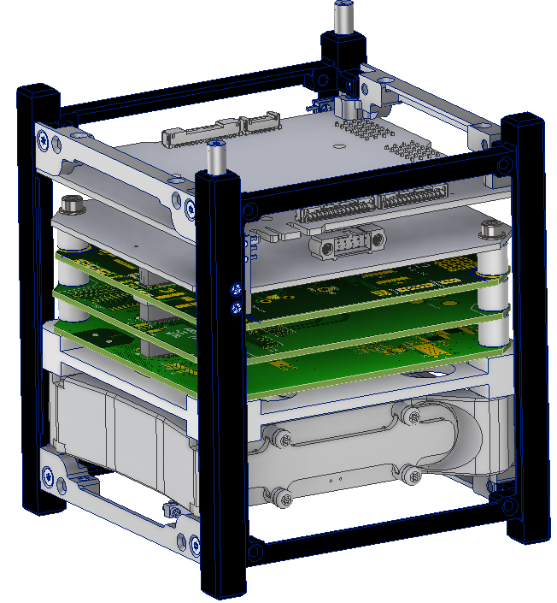
Assembly Process

Slide 11
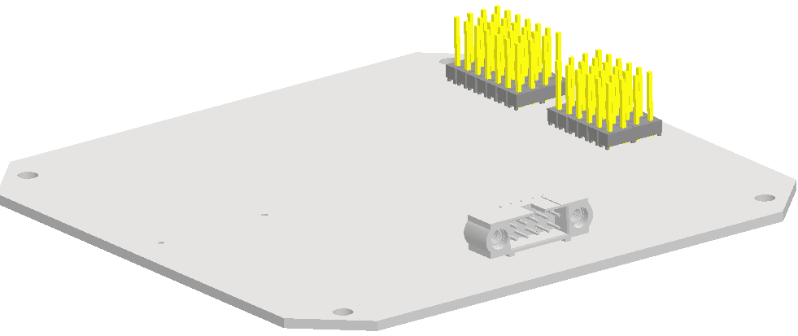
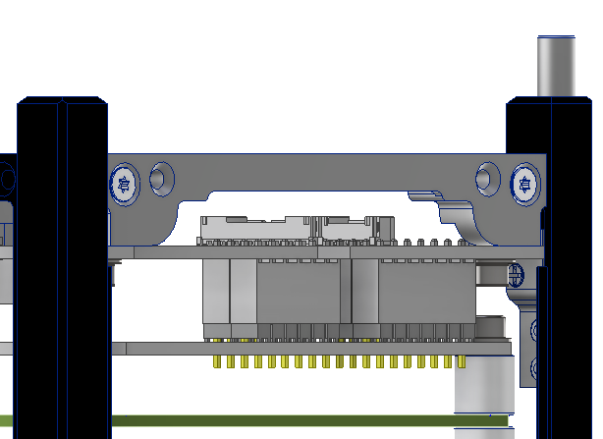
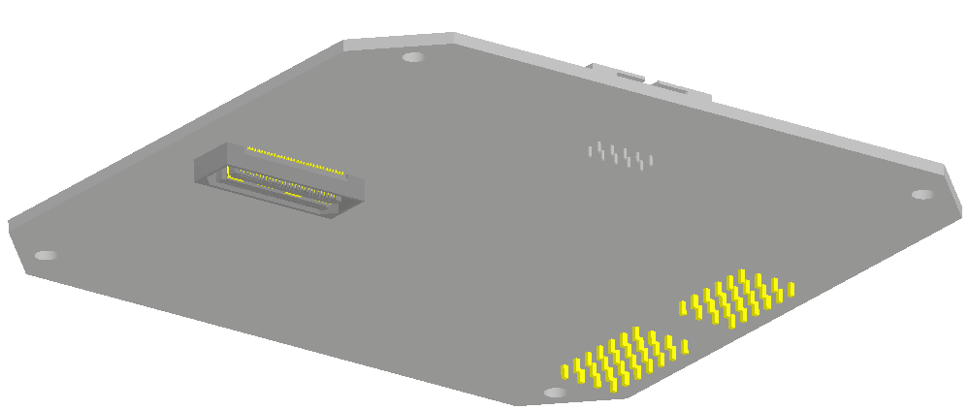
Power Signal Adapter
(2) MTSW-107-08-L-D-300 -235
(2) MTSW-106-08-L-D-300 -235
Top
GOLF/FOX-ME-113 Bolt Hole Pattern
96mm
92mm
Bottom
PIU
PSA
Samtec QSH-030-01-L-D-A
LIHU

Slide 12
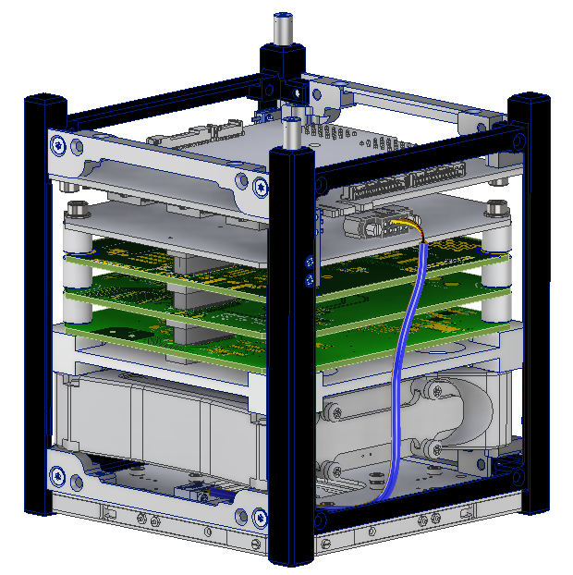
Current Status
FOX-ME-204 Power Signal Adapter design finalized; release pending minor updates
FOX-ME-203 Mechanical Adapter drawing Work In Progress (WIP); metal parts fabricated and in-house
Hardware (fasteners, spacers, etc.) in-house; mechanical fit model constructed on ISISpace assembly jig
Solar Array “blanks” designed, fabricated, and in-house
FOX-ME-202 (TLA) and Assembly Procedures WIP

Slide 13
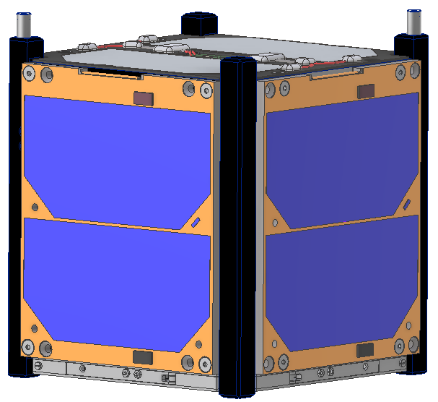
Path Forward
Route wires/cables as needed leveraging built-in AutoDesk Inventor toolbox
Support Engineering Model (EM) buildup and subsequent tests
Finalize and release drawings and documents to support Flight Model build, test, and launch
Update design and layout as needed for FoxPlus-B

Slide 14
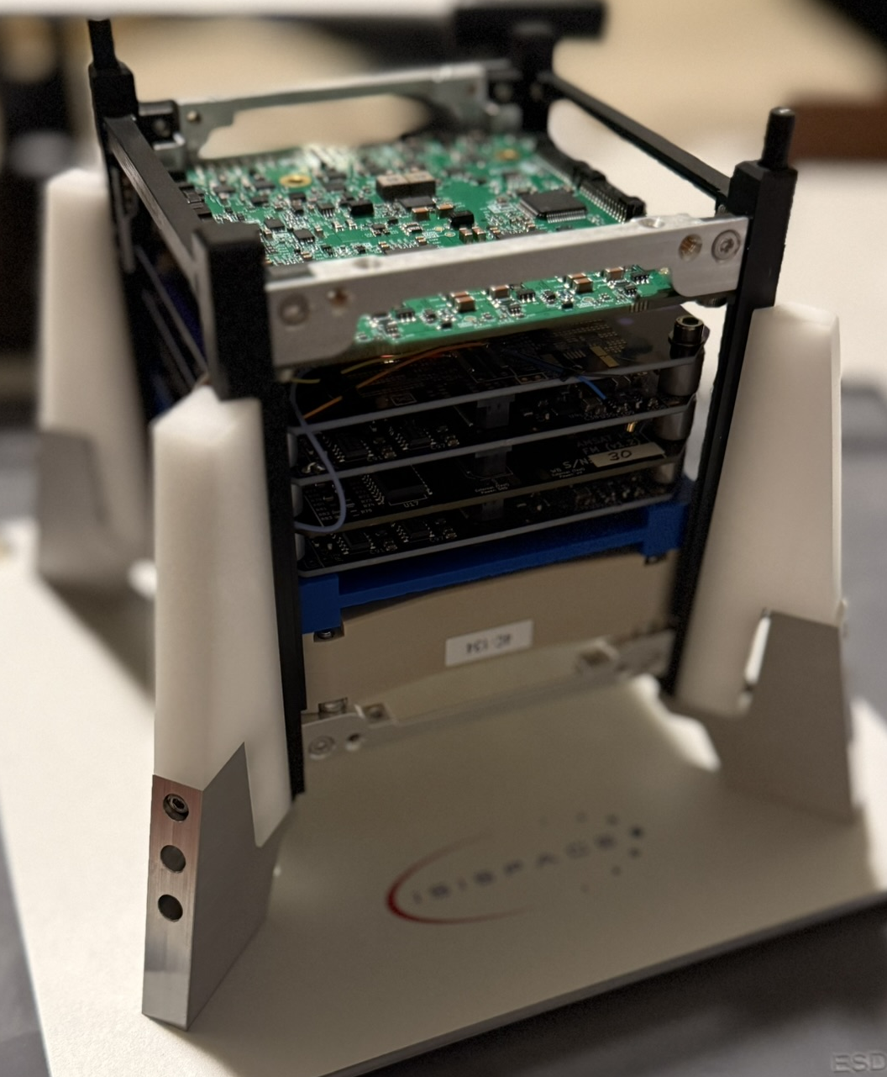
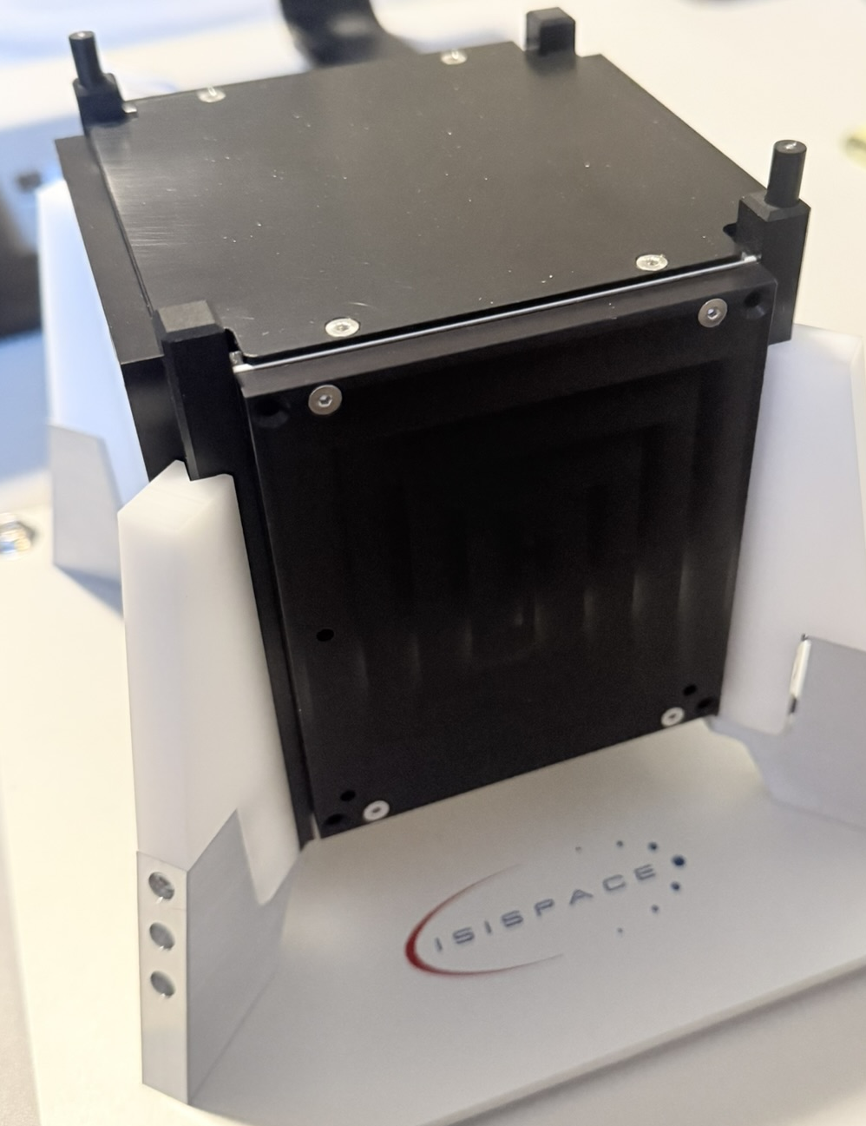
End

